Slide 1
Bilateral Loop Filter in Combination with Sample Adaptive Offset (SAO)
Jacob Ström, Per Wennersten, Jack Enhorn, Du Liu, Kenneth Andersson and Rickard Sjöberg
Ericsson Research

Slide 2
Background
ringing artifacts
Transform coding leads to ringing artifacts
transform
quantization
inverse transform

Slide 3
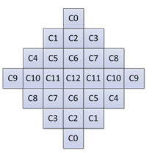
Tools that help with ringing in Versatile Video Coding (VVC)
Sample adaptive offset (SAO): Identifies certain samples using patterns or value range and adds a signaled offset.
Adaptive loop filtering (ALF): Identifies certain samples using gradients and activity and applies a signaled filter.
The idea is to improve this further.
ALF filter support for luma

Slide 4
Filtering

Slide 5
Filtering
To filter out noise you want to average over similar samples.

Slide 6
Filtering
To filter out noise you want to average over similar samples.
In Gaussian filtering the idea is that the closer a sample is, the more it has in common with the sample to be filtered.
$$Δx$$
$$Δy$$

Slide 7
Filtering
To filter out noise you want to average over similar samples.
In Gaussian filtering the idea is that the closer a sample is, the more it has in common with the sample to be filtered.
The weight of a neighbor sample decreases with distance:
$$w_{Δx,Δy} \sim e^{− \frac{Δx^{2}+Δy^{2}}{2σ^{2}}}$$
$$Δx$$
$$Δy$$

Slide 8
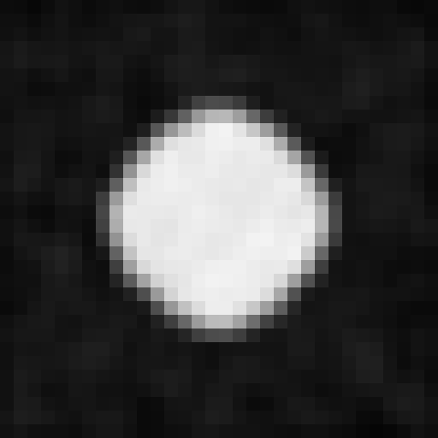
Filtering
Less noise …
$$Δx$$
$$Δy$$
… but blurred
edge.
original image
After Gaussian filtering

Slide 9
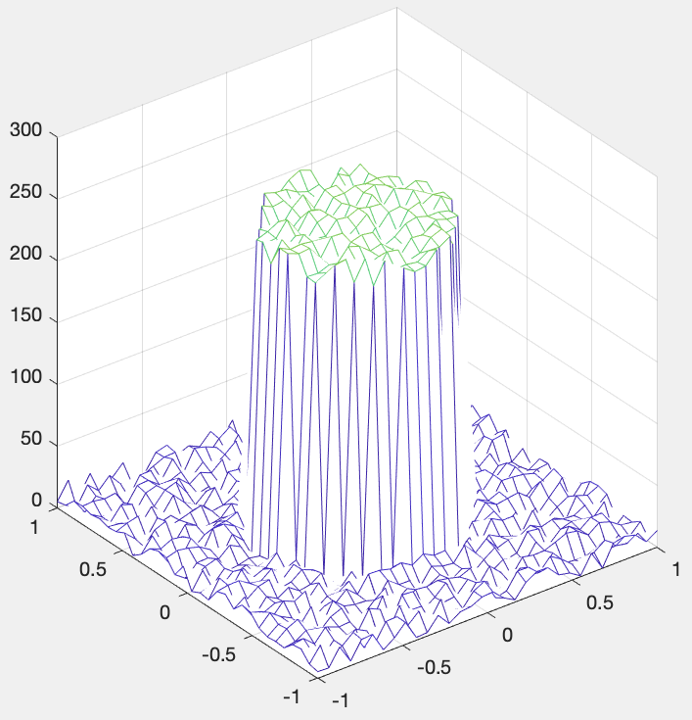
Bilateral filtering
original image
same image but where intensity is plotted as the third dimension

Slide 10
Bilateral filtering
$$Δy$$
$$Δx$$
$$Δx$$
$$Δy$$
original image
same image but where intensity is plotted as the third dimension

Slide 11
Filtering
In bilateral filtering the idea is to take the distance both in the spatial domain (distance in pixels) and in the intensity domain (distance in intensity).
$w_{Δx,Δy} \sim e^{− \frac{Δx^{2}+Δy^{2}}{2σ^{2}} − \frac{ΔI^{2}}{2τ^{2}}}$
$$Δy$$
$$Δx$$
$$ΔI$$
same image but where intensity is plotted as the third dimension

Slide 12
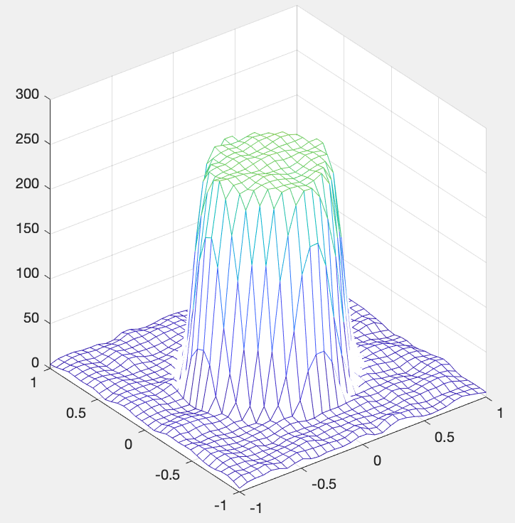
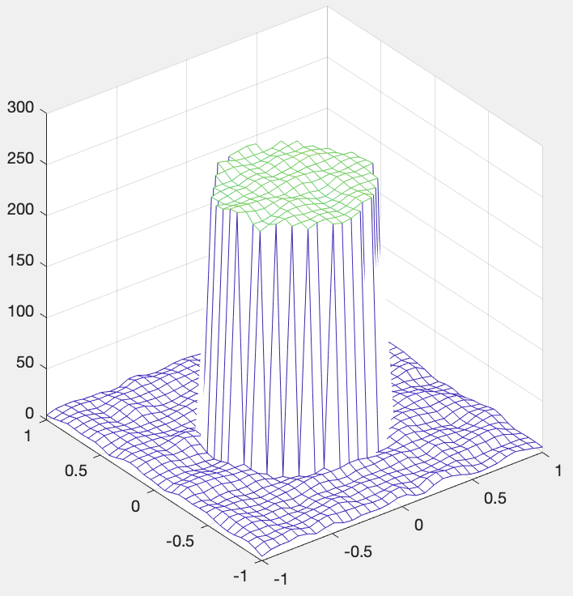
Bilateral filtering
original
Gaussian filter
bilateral filter

Slide 13
[Wennersten2017]
The version of the filter that was included into the Joint Exploration Model (JEM), which was an exploratory work before VVC.
Bilateral filtering is applied right after reconstruction.
prediction
clip to [0, 255]
bilateral filter
$$T^{−1}$$
transform coefficients
decoded residual
reconstruction
new
reconstruction
[Wennersten2017] P. Wennersten, J. Ström, Y. Wang, K. Andersson, R. Sjo ̈berg and J. Enhorn, “Bilateral Filtering for Video Coding,” in Proceedings of the IEEE International Conference on Visual Communications and Image Processing (VCIP), Saint Petersburg, FL, USA, Dec. 2017.

Slide 14
[Wennersten2017]
original
after reconstruction
Strong filtering
removes noise
may remove signal also
Weaker filtering
removes less noise
removes less signal

Slide 15
[Wennersten2017]
$$w_{Δx,Δy} \sim e^{− \frac{Δx^{2}+Δy^{2}}{2σ^{2}}}∗e^{− \frac{ΔI^{2}}{2τ^{2}}}$$
spatial strength
(controlled by block size)
intensity strength (controlled by QP)
original
after reconstruction
Strong filtering
removes noise
may remove signal also
Weaker filtering
removes less noise
removes less signal

Slide 16
[Wennersten2017]
Was included into JEM
Performance under JEM conformance test conditions in terms of Bjontegaard Delta Rate (BDR)
All intra: -0.4% BDR 106% encoder run time 105% decoder run time
Random access: -0.5% BDR 103% encoder run time 100% decoder run time
Drawbacks:
Needs multiplication
Limited filter size limits effectiveness
Is in critical path
This paper addresses these issues
$$I_{A}$$
$$I_{L}$$
$$I_{C}$$
$$I_{R}$$
$$I_{B}$$

Slide 17
Addressing drawback #1: Multiplications
$$ΔI_{A}=I_{A}−I_{C}$$
$$I_{A}$$
$I_{F}=I_{C}+\frac{\left(w_{A}×ΔI_{A}+w_{B}×ΔI_{B}+w_{L}×ΔI_{L}+w_{R}×ΔI_{R}\right)}{w_{C}+w_{A}+w_{B}+w_{L}+w_{R}}$
$$I_{L}$$
$$I_{C}$$
$$I_{R}$$
$$I_{B}$$

Slide 18
Addressing drawback #1: Multiplications
$$ΔI_{A}=I_{A}−I_{C}$$
$$I_{A}$$
$I_{F}=I_{C}+\frac{\left(w_{A}×ΔI_{A}+w_{B}×ΔI_{B}+w_{L}×ΔI_{L}+w_{R}×ΔI_{R}\right)}{w_{C}+w_{A}+w_{B}+w_{L}+w_{R}}$
Using a clever approximation proposed by [Chen2018] the division can be removed:
$$I_{F}=I_{C}+d\left(σ\right)×\left[{\hat{w}}_{A}×ΔI_{A}+{\hat{w}}_{B}×ΔI_{B}+{\hat{w}}_{L}×ΔI_{L}+{\hat{w}}_{R}×ΔI_{R}\right]$$
where $\hat{w}=e^{− \frac{{\left|ΔI\right|}^{2}}{2τ^{2}}}$
$$I_{L}$$
$$I_{C}$$
$$I_{R}$$
$$I_{B}$$
[Chen2018] Y.-W. Chen et al. “Description of SDR, HDR and 360 video coding technology proposal by Qualcomm and Technicolor low and high complexity versions” in Joint Video Exploration Team (JVET) of ITU-T SG 16 WP 3 and ISO/IEC JTC 1/SC 29/WG 11 10th Meeting, Input document JVET-N0493, San Diego, US, 10-20 Apr 2018

Slide 19
Addressing drawback #1: Multiplications
$$ΔI_{A}=I_{A}−I_{C}$$
$$I_{A}$$
$I_{F}=I_{C}+\frac{\left(w_{A}×ΔI_{A}+w_{B}×ΔI_{B}+w_{L}×ΔI_{L}+w_{R}×ΔI_{R}\right)}{w_{C}+w_{A}+w_{B}+w_{L}+w_{R}}$
Using a clever approximation proposed by [Chen2018] the division can be removed:
$$I_{F}=I_{C}+d\left(σ\right)×\left[{\hat{w}}_{A}×ΔI_{A}+{\hat{w}}_{B}×ΔI_{B}+{\hat{w}}_{L}×ΔI_{L}+{\hat{w}}_{R}×ΔI_{R}\right]$$
where $\hat{w}=e^{− \frac{{\left|ΔI\right|}^{2}}{2τ^{2}}}$
Our proposal: create a 2D look-up table $LUT\left(ΔI, τ\right)=e^{− \frac{{\left|ΔI\right|}^{2}}{2τ^{2}}}×ΔI$
$$I_{L}$$
$$I_{C}$$
$$I_{R}$$
$$I_{B}$$
[Chen2018] Y.-W. Chen et al. “Description of SDR, HDR and 360 video coding technology proposal by Qualcomm and Technicolor low and high complexity versions” in Joint Video Exploration Team (JVET) of ITU-T SG 16 WP 3 and ISO/IEC JTC 1/SC 29/WG 11 10th Meeting, Input document JVET-N0493, San Diego, US, 10-20 Apr 2018

Slide 20
Addressing drawback #1: Multiplications
$$ΔI_{A}=I_{A}−I_{C}$$
$$I_{A}$$
$I_{F}=I_{C}+\frac{\left(w_{A}×ΔI_{A}+w_{B}×ΔI_{B}+w_{L}×ΔI_{L}+w_{R}×ΔI_{R}\right)}{w_{C}+w_{A}+w_{B}+w_{L}+w_{R}}$
Using a clever approximation proposed by [Chen2018] the division can be removed:
$$I_{F}=I_{C}+d\left(σ\right)×\left[{\hat{w}}_{A}×ΔI_{A}+{\hat{w}}_{B}×ΔI_{B}+{\hat{w}}_{L}×ΔI_{L}+{\hat{w}}_{R}×ΔI_{R}\right]$$
where $\hat{w}=e^{− \frac{{\left|ΔI\right|}^{2}}{2τ^{2}}}$
Our proposal: create a 2D look-up table $LUT\left(ΔI, τ\right)=e^{− \frac{{\left|ΔI\right|}^{2}}{2τ^{2}}}×ΔI$
$$I_{L}$$
$$I_{C}$$
$$I_{R}$$
$$I_{B}$$
$$I_{F}=I_{C}+d\left(σ\right)×\left[LUT(ΔI_{A},τ)+LUT(ΔI_{A},τ)+LUT(ΔI_{A},τ)+LUT(ΔI_{A},τ)\right]$$
[Chen2018] Y.-W. Chen et al. “Description of SDR, HDR and 360 video coding technology proposal by Qualcomm and Technicolor low and high complexity versions” in Joint Video Exploration Team (JVET) of ITU-T SG 16 WP 3 and ISO/IEC JTC 1/SC 29/WG 11 10th Meeting, Input document JVET-N0493, San Diego, US, 10-20 Apr 2018

Slide 21
Addressing drawback #1: Avoiding multiplications
Still have one multiplication
$$I_{F}=I_{C}+d\left(σ\right)×\left[LUT(ΔI_{A},τ)+LUT(ΔI_{A},τ)+LUT(ΔI_{A},τ)+LUT(ΔI_{A},τ)\right]$$

Slide 22
Addressing drawback #1: Avoiding multiplications
Still have one multiplication
$$I_{F}=I_{C}+d\left(σ\right)×\left[LUT(ΔI_{A},τ)+LUT(ΔI_{A},τ)+LUT(ΔI_{A},τ)+LUT(ΔI_{A},τ)\right]$$
Naïve solution: three-dimensional look-up table. Too expensive.

Slide 23
Addressing drawback #1: Avoiding multiplications
Still have one multiplication
$$I_{F}=I_{C}+d\left(σ\right)×\left[LUT(ΔI_{A},τ)+LUT(ΔI_{A},τ)+LUT(ΔI_{A},τ)+LUT(ΔI_{A},τ)\right]$$
Naïve solution: three-dimensional look-up table. Too expensive.
Proposed solution: Only allow 3 values of $d\left(σ\right)=\left\{d, 2d, 3d\right\}$

Slide 24
Addressing drawback #1: Avoiding multiplications
Still have one multiplication
$$I_{F}=I_{C}+d\left(σ\right)×\left[LUT(ΔI_{A},τ)+LUT(ΔI_{A},τ)+LUT(ΔI_{A},τ)+LUT(ΔI_{A},τ)\right]$$
Naïve solution: three-dimensional look-up table. Too expensive.
Proposed solution: Only allow 3 values of $d\left(σ\right)=\left\{d, 2d, 3d\right\}$
Bake constant $d$ into the LUT: $LUT_{1}\left(ΔI, τ\right)=d×LUT(ΔI, τ)$.
$$I_{F}=I_{C}+\{1, 2 or 3\}×\left[LUT_{d}(ΔI_{A},τ)+LUT_{d}(ΔI_{A},τ)+LUT_{d}(ΔI_{A},τ)+LUT_{d}(ΔI_{A},τ)\right]$$

Slide 25
Addressing drawback #1: Avoiding multiplications
Still have one multiplication
$$I_{F}=I_{C}+d\left(σ\right)×\left[LUT(ΔI_{A},τ)+LUT(ΔI_{A},τ)+LUT(ΔI_{A},τ)+LUT(ΔI_{A},τ)\right]$$
Naïve solution: three-dimensional look-up table. Too expensive.
Proposed solution: Only allow 3 values of $d\left(σ\right)=\left\{d, 2d, 3d\right\}$
Bake constant $d$ into the LUT: $LUT_{1}\left(ΔI, τ\right)=d×LUT(ΔI, τ)$.
$$I_{F}=I_{C}+\{1, 2 or 3\}×\left[LUT_{d}(ΔI_{A},τ)+LUT_{d}(ΔI_{A},τ)+LUT_{d}(ΔI_{A},τ)+LUT_{d}(ΔI_{A},τ)\right]$$
A multiplication with 1, 2 or 3 can be implemented using a single addition in hardware and shift
$1x = x$
$2x = x≪1$
$3x = x≪1 + x$

Slide 26
Addressing drawback #2: Increasing the filter size
Only one distance to center sample
Two different distances to center sample

Slide 27
Addressing drawback #2: Increasing the filter size
This would translate to having two look-up tables
$LUT_{d_{1}}\left(ΔI, τ\right)=d_{1}×LUT(ΔI, τ)$.
$LUT_{d_{2}}\left(ΔI, τ\right)=d_{2}×LUT(ΔI, τ)$.
Only one distance to center sample
Two different distances to center sample

Slide 28
Addressing drawback #2: Increasing the filter size
This would translate to having two look-up tables
$LUT_{d_{1}}\left(ΔI, τ\right)=d_{1}×LUT(ΔI, τ)$.
$LUT_{d_{2}}\left(ΔI, τ\right)=d_{2}×LUT(ΔI, τ)$.
Instead, we use the same look-up table and just shift by two if it is a diagonal sample:
Use $LUT_{d}\left(ΔI,τ\right)≫1$ for diagonal samples
Use $LUT_{d}\left(ΔI,τ\right)$ for the regular samples
Only one distance to center sample
Two different distances to center sample

Slide 29
Addressing drawback #3: Avoiding the critical path
Before we can predict this block…
For intra blocks, you need the filtered version of the previous block to get the prediction of the next block
This is a bottleneck in some hardware implementations.
prediction
transform coefficients
decoded residual
clip to [0, 1023]
recon- struction
$$T^{−1}$$

Slide 30
Addressing drawback #3: Avoiding the critical path
… this block must be finished.
Before we can predict this block…
For intra blocks, you need the filtered version of the previous block to get the prediction of the next block
This is a bottleneck in some hardware implementations.
prediction
transform coefficients
decoded residual
clip to [0, 1023]
recon- struction
$$T^{−1}$$

Slide 31
Addressing drawback #3: Avoiding the critical path
… this block must be finished.
Before we can predict this block…
For intra blocks, you need the filtered version of the previous block to get the prediction of the next block
This is a bottleneck in some hardware implementations.
prediction
transform coefficients
decoded residual
clip to [0, 1023]
recon- struction
bilateral filter
new recon- struction
$$T^{−1}$$

Slide 32
Addressing drawback #3: Avoiding the bottleneck
Instead of filtering each block at the time it is decoded, we wait until all blocks have been decoded

Slide 33
Avoiding the bottleneck
Instead of filtering each block at the time it is decoded, we wait until all blocks have been decoded
In VVC this is called the loopfilter stage.
Current VVC implementation has three loop-filters:
Deblocking
SAO
ALF
One solution could be to add a fourth loopfilter stage that performs bilateral filtering.
This would solve the bottleneck issue, but to introduce too many loop-filter stages according to HW experts.

Slide 34
Sharing loop-filter stage with SAO
As can be seen in the figure, the same surrounding samples are used for SAO as for the bilateral filter.

Slide 35
Sharing loop-filter stage with SAO
Both filter and SAO uses the same samples – SAO does not have to wait for bilateral filter or vice versa.
An implementation can choose to filter bilateral first, SAO first, or in lock-step per sample.
bilateral, clip
bilateral
SAO
SAO, clip

Slide 36
Results over VTM-6.0
BDR Y Enc run-time Dec run-time
All intra config: -0.40% 106% 104%
Random access config: -0.44% 103% 102%
Low-delay B config: -0.32% 102% 102%
Low-delay P config: -0.39% 103% 102%
LUT: SIMD-friendly (never above 16 bytes long), 60 bytes in total
Two subjective tests were carried out at two JVET meetings
Gothenburg [JVET-O1118]: Out of 12 examples, one was statistically significant and one almost (confidence interval just touching).
Geneva [JVET-P1032]: Out of 6 examples, one almost statistically significant (confidence interval just touching).

Slide 37
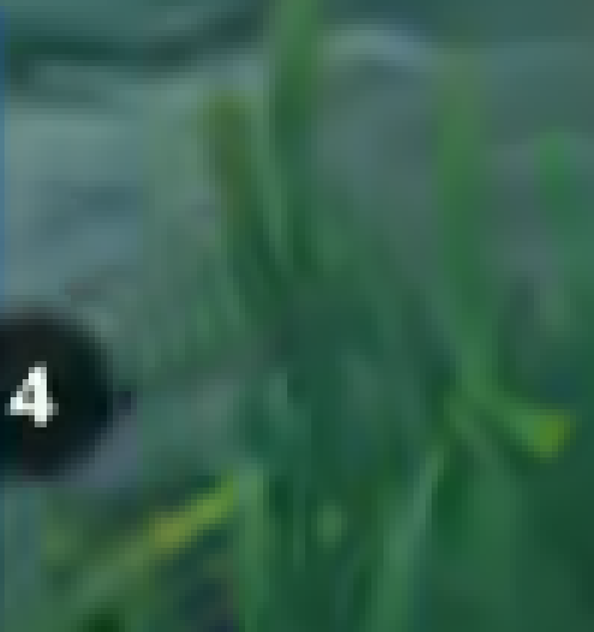
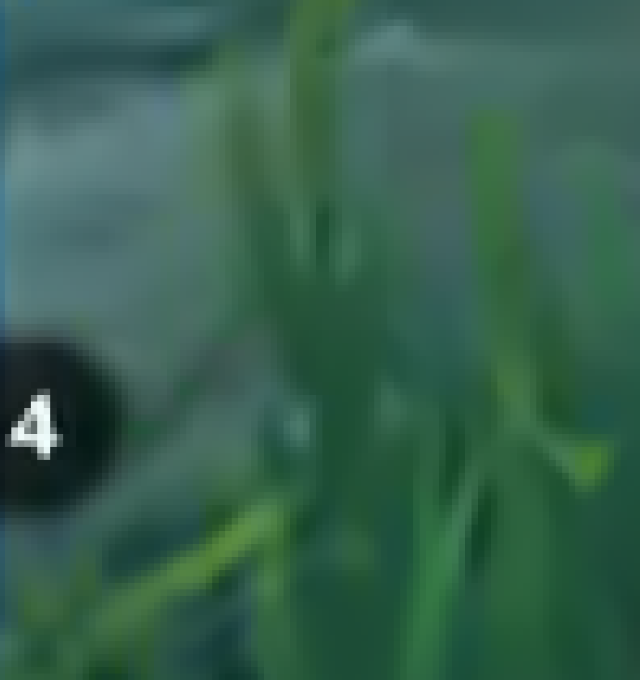
Example
VTM6.0
VTM6.0 + bilateral filter

Slide 38
Example
VTM6.0
VTM6.0 + bilateral filter

Slide 39
Example
VTM6.0
VTM6.0 + bilateral filter

Slide 40
Example
VTM6.0
VTM6.0 + bilateral filter

Slide 41
Example
VTM6.0
VTM6.0 + bilateral filter

Slide 42
Example
VTM6.0
VTM6.0 + bilateral filter

Slide 43
Summary
We have described the background and the latest developments for the bilateral filter
Three contributions
Removal of multiplication
Increase in filter size
Combination with SAO to avoid hardware bottleneck

Slide 44
Thank you!

Slide 46
Limitations
The encoder must decide what partitioning to use – this is called the RDO process.
A big block may cost fewer bits, but create too much ringing.
However, if this ringing is removed by the bilateral filter in the loop filter stage, it may still be the best option.
Our encoder therefore does bilateral filtering during the RDO process.
This requires an inverse transform in the encoder, which is expensive.
or
?

Slide 47
Example
VTM6.0 + bilateral filter with RDO optimization
VTM6.0 + bilateral filter without RDO optimization
VTM6.0

Slide 48
Results over VTM-5.0
BDR Y Enc run-time Dec run-time
All intra config: -0.40% 106% 104%
Random access config: -0.50% 102% 102%
Low-delay B config: -0.31% 103% 104%
LUT: SIMD-friendly (never above 16 bytes long), 60 bytes in total
Two subjective tests were carried out at two JVET meetings
Gothenburg [JVET-O1118]: Out of 12 examples, one was statistically significant and one almost (confidence interval just touching).
Geneva [JVET-P1032]: Out of 6 examples, one almost statistically significant (confidence interval just touching).

Slide 49
Outline
What we try to accomplish
How bilateral filters work
Previous work in detail
The contribution of this paper

Slide 50
Gaussian filtering
Weights depend on squared distance to center of filter.
$$w_{Δx,Δy}=e^{− \frac{Δx^{2}+Δy^{2}}{2σ^{2}}}$$
$$d^{2}=1^{2}+1^{2}$$
d
1
1

Slide 51
Gaussian filtering
Example
Weights depend on squared distance to center of filter.
$$w_{Δx,Δy}=e^{− \frac{Δx^{2}+Δy^{2}}{2σ^{2}}}$$
If $σ=0.8493$ we get
$$w_{Δx,Δy}=\left[\begin{matrix}0.25 & 0.5 & 0.25 \\ 0.5 & 1 & 0.5 \\ 0.25 & 0.5 & 0.25\end{matrix}\right]$$
$$d^{2}=1^{2}+1^{2}$$
d
1
1

Slide 52
Gaussian filtering
Example
Weights depend on squared distance to center of filter.
$$w_{Δx,Δy}=e^{− \frac{Δx^{2}+Δy^{2}}{2σ^{2}}}$$
If $σ=0.8493$ we get
$$w_{Δx,Δy}=\left[\begin{matrix}0.25 & 0.5 & 0.25 \\ 0.5 & 1 & 0.5 \\ 0.25 & 0.5 & 0.25\end{matrix}\right]$$
$$d^{2}=1^{2}+1^{2}$$
d
1
1
Normalizing filter coefficients to 1:
$$c_{Δx,Δy}=\frac{w_{Δx,Δy}}{\sum_{all w}{w}}$$

Slide 53
Gaussian filtering
Example
Weights depend on squared distance to center of filter.
$$w_{Δx,Δy}=e^{− \frac{Δx^{2}+Δy^{2}}{2σ^{2}}}$$
If $σ=0.8493$ we get
$$w_{Δx,Δy}=\left[\begin{matrix}0.25 & 0.5 & 0.25 \\ 0.5 & 1 & 0.5 \\ 0.25 & 0.5 & 0.25\end{matrix}\right]$$
$$d^{2}=1^{2}+1^{2}$$
d
1
1
Normalizing filter coefficients to 1:
$$c_{Δx,Δy}=\frac{w_{Δx,Δy}}{\sum_{all w}{w}}$$
After normalizing we get
$$c_{Δx,Δy}=\left[\begin{matrix}0.0625 & 0.125 & 0.0625 \\ 0.125 & 0.25 & 0.125 \\ 0.0625 & 0.125 & 0.0625\end{matrix}\right]$$

Slide 54
Gaussian Filtering blurs edges
Less noise …
3x3 Gaussian filter
$$\left[\begin{matrix}0.0625 & 0.125 & 0.0625 \\ 0.125 & 0.25 & 0.125 \\ 0.0625 & 0.125 & 0.0625\end{matrix}\right]$$
… but blurred edge.

Slide 55
Gaussian filtering blurs edges
$$≈1023$$
$$≈0$$
Even with a small weight such as $0.0625$, its contribution is large enough to be visible
$$1023×0.0625 =64$$
Middle pixel will brighten by 64 intensity steps.
$$\left[\begin{matrix}0.0625 & 0.125 & 0.0625 \\ 0.125 & 0.25 & 0.125 \\ 0.0625 & 0.125 & 0.0625\end{matrix}\right]$$

Slide 56
Bilateral filtering
$$d^{2}=1^{2}+1^{2}$$
The weights depend on the squared distance to the center of the filter and the intensity difference
$$w_{Δx,Δy}=e^{− \frac{Δx^{2}+Δy^{2}}{2σ^{2}}}∗e^{− \frac{{\left|ΔI\left(x,y\right)\right|}^{2}}{2τ^{2}}}$$
1
1
d
$${ΔI(x,y)}^{2}={\left(1023−0\right)}^{2}$$

Slide 57
Bilateral filtering
Example
$$d^{2}=1^{2}+1^{2}$$
The weights depend on the squared distance to the center of the filter and the intensity difference
$$w_{Δx,Δy}=e^{− \frac{Δx^{2}+Δy^{2}}{2σ^{2}}}∗e^{− \frac{{\left|ΔI\left(x,y\right)\right|}^{2}}{2τ^{2}}}$$
If $σ=0.8493$ we get
$$w_{Δx,Δy}=\left[\begin{matrix}0 & 0.4995 & 0.2467 \\ 0.4899 & 1 & 0.4842 \\ 0.2424 & 0.4817 & 0.2492\end{matrix}\right]$$
1
1
d
$${ΔI(x,y)}^{2}={\left(1023−0\right)}^{2}$$
Normalizing filter coefficients to 1:
$$c_{Δx,Δy}=\frac{w_{Δx,Δy}}{\sum_{all}{w}}$$
After normalizing we get
$$c_{Δx,Δy}=\left[\begin{matrix}0 & 0.1342 & 0.0675 \\ 0.1295 & 0.2712 & 0.1337 \\ 0.0671 & 0.1298 & 0.0669\end{matrix}\right]$$

Slide 58
[Wennersten2017]
original
after reconstruction
Strong filtering
removes noise
may remove signal also
Weaker filtering
removes less noise
removes less signal

Slide 59
[Wennersten2017]
$w_{Δx,Δy}=e^{− \frac{Δx^{2}+Δy^{2}}{2σ^{2}}}∗e^{− \frac{{\left|ΔI\left(x,y\right)\right|}^{2}}{2τ^{2}}}$
Filter strength set on heuristics in Wennersten2017
Higher QP -> larger compression artifacts -> stronger filtering better
Set intensity strength as a function of QP:
$τ=max⁡(\frac{QP−17}{2}, 0.01)$
Smaller blocks -> sharp edges -> more ringing -> stronger filtering better
Set spatial strength as a function of transform block size:
$σ=0.92−\frac{1}{40}min⁡(width, height, 16)$
spatial strength
intensity strength

Slide 60
Drawbacks with [Wennersten2017]
Weights are different for every sample, since $ΔI$ is different
$w_{Δx,Δy}=e^{− \frac{Δx^{2}+Δy^{2}}{2σ^{2}}}∗e^{− \frac{{\left|ΔI\left(x,y\right)\right|}^{2}}{2τ^{2}}}$

Slide 61
Drawbacks with [Wennersten2017]
Weights are different for every sample, since $ΔI$ is different
$w_{Δx,Δy}=e^{− \frac{Δx^{2}+Δy^{2}}{2σ^{2}}}∗e^{− \frac{{\left|ΔI\left(x,y\right)\right|}^{2}}{2τ^{2}}}$
This means that the normalizing denominator will be different
$c_{Δx,Δy}=\frac{w_{Δx,Δy}}{\sum_{all}{w}}$
different every sample

Slide 62
Drawbacks with [Wennersten2017]
Weights are different for every sample, since $ΔI$ is different
$w_{Δx,Δy}=e^{− \frac{Δx^{2}+Δy^{2}}{2σ^{2}}}∗e^{− \frac{{\left|ΔI\left(x,y\right)\right|}^{2}}{2τ^{2}}}$
This means that the normalizing denominator will be different
$c_{Δx,Δy}=\frac{w_{Δx,Δy}}{\sum_{all}{w}}$
A division per pixel is necessary. ([Wennersten2017] used a division table)
different every sample

Slide 63
Drawbacks with [Wennersten2017]
Weights are different for every sample, since $ΔI$ is different
$w_{Δx,Δy}=e^{− \frac{Δx^{2}+Δy^{2}}{2σ^{2}}}∗e^{− \frac{{\left|ΔI\left(x,y\right)\right|}^{2}}{2τ^{2}}}$
This means that the normalizing denominator will be different
$c_{Δx,Δy}=\frac{w_{Δx,Δy}}{\sum_{all}{w}}$
A division per pixel is necessary. ([Wennersten2017] used a division table)
This was addressed by [Chen2018]:
They use $w_{Δx,Δy}=e^{− \frac{Δx^{2}+Δy^{2}}{2σ^{2}}}∗e^{− \frac{{\left|ΔI\left(x,y\right)\right|}^{2}}{2τ^{2}}}$ in numerator, but
${\hat{w}}_{Δx,Δy}=e^{− \frac{Δx^{2}+Δy^{2}}{2σ^{2}}}$ in denominator
different every sample

Slide 64
Drawbacks with [Wennersten2017]
Weights are different for every sample, since $ΔI$ is different
$w_{Δx,Δy}=e^{− \frac{Δx^{2}+Δy^{2}}{2σ^{2}}}∗e^{− \frac{{\left|ΔI\left(x,y\right)\right|}^{2}}{2τ^{2}}}$
This means that the normalizing denominator will be different
$c_{Δx,Δy}=\frac{w_{Δx,Δy}}{\sum_{all}{w}}$
A division per pixel is necessary. ([Wennersten2017] used a division table)
This was addressed by [Chen2018]:
They use $w_{Δx,Δy}=e^{− \frac{Δx^{2}+Δy^{2}}{2σ^{2}}}∗e^{− \frac{{\left|ΔI\left(x,y\right)\right|}^{2}}{2τ^{2}}}$ in numerator, but
${\hat{w}}_{Δx,Δy}=e^{− \frac{Δx^{2}+Δy^{2}}{2σ^{2}}}$ in denominator
$c_{Δx,Δy}=\frac{w_{Δx,Δy}}{\sum_{all}{\hat{w}}}$
different every sample
sum same every sample – change to multiplication with $1/\sum_{all}{\hat{w}}$

Slide 65
Drawbacks with [Wennersten2017]
$$I_{A}$$
Small filter size
Only 4-neighbors used
Can only cancel high frequency ringing
Multiplications needed:
$I_{F}=I_{C}+\frac{w_{A} ∗ΔI_{A}+w_{B} ∗ΔI_{B}+w_{L} ∗ΔI_{L}+w_{R} ∗ΔI_{R}}{w_{C}+w_{A}+w_{B}+w_{L}+w_{R}}$
$$I_{L}$$
$$I_{C}$$
$$I_{R}$$
$$I_{B}$$

Slide 66
Contributions of this paper
A way to combine the filter with SAO to avoid the prediction bottleneck
An increase in filter size
A simplification of the filter that avoids multiplications

Slide 67
Addressing drawback #1: Increasing the filter size
Increasing the filter size makes it possible to remove more types of ringing.

Slide 68
Problem of having too many loopfilter stages
Simplest implementation is to filter entire image before starting with next:
Deblock entire image, and then
Perform SAO on entire image, and then,
Perform ALF on entire image
To reduce latency, many implementations filter in parallel, for instance
Deblock top quarter, and then
Perform SAO on top quarter while deblocking second quarter, and then
Perform ALF on top quarter, SAO on second quarter and deblocking on third
A problem occurs if one stage takes longer than normal – then the next stages cannot start because of has not gotten the data yet (data starvation)
Creating one new loopfilter stage makes this situation even worse

Slide 69
Problem of having too many loopfilter stages
Simplest implementation is to filter entire image before starting with next:
Deblock entire image, and then
Perform SAO on entire image, and then,
Perform ALF on entire image
To reduce latency, many implementations filter in parallel, for instance
Deblock top quarter, and then
Perform SAO on top quarter while deblocking second quarter, and then
Perform ALF on top quarter, SAO on second quarter and deblocking on third
A problem occurs if one stage takes longer than normal – then the next stages cannot start because of has not gotten the data yet (data starvation)
Creating one new loopfilter stage makes this situation even worse
deblock

Slide 70
Problem of having too many loopfilter stages
Simplest implementation is to filter entire image before starting with next:
Deblock entire image, and then
Perform SAO on entire image, and then,
Perform ALF on entire image
To reduce latency, many implementations filter in parallel, for instance
Deblock top quarter, and then
Perform SAO on top quarter while deblocking second quarter, and then
Perform ALF on top quarter, SAO on second quarter and deblocking on third
A problem occurs if one stage takes longer than normal – then the next stages cannot start because of has not gotten the data yet (data starvation)
Creating one new loopfilter stage makes this situation even worse
SAO
deblock

Slide 71
Problem of having too many loopfilter stages
Simplest implementation is to filter entire image before starting with next:
Deblock entire image, and then
Perform SAO on entire image, and then,
Perform ALF on entire image
To reduce latency, many implementations filter in parallel, for instance
Deblock top quarter, and then
Perform SAO on top quarter while deblocking second quarter, and then
Perform ALF on top quarter, SAO on second quarter and deblocking on third
A problem occurs if one stage takes longer than normal – then the next stages cannot start because of has not gotten the data yet (data starvation)
Creating one new loopfilter stage makes this situation even worse
ALF
SAO
deblock

Slide 72
Problem of having too many loopfilter stages
Simplest implementation is to filter entire image before starting with next:
Deblock entire image, and then
Perform SAO on entire image, and then,
Perform ALF on entire image
To reduce latency, many implementations filter in parallel, for instance
Deblock top quarter, and then
Perform SAO on top quarter while deblocking second quarter, and then
Perform ALF on top quarter, SAO on second quarter and deblocking on third
A problem occurs if one stage takes longer than normal – then the next stages cannot start because of has not gotten the data yet (data starvation)
Creating one new loopfilter stage makes this situation even worse
ALF
SAO
deblock

Slide 73
Problem of having too many loopfilter stages
Simplest implementation is to filter entire image before starting with next:
Deblock entire image, and then
Perform SAO on entire image, and then,
Perform ALF on entire image
To reduce latency, many implementations filter in parallel, for instance
Deblock top quarter, and then
Perform SAO on top quarter while deblocking second quarter, and then
Perform ALF on top quarter, SAO on second quarter and deblocking on third
A problem occurs if one stage takes longer than normal – then the next stages cannot start because of has not gotten the data yet (data starvation)
Creating one new loopfilter stage makes this situation even worse
ALF
SAO

Slide 74
Problem of having too many loopfilter stages
Simplest implementation is to filter entire image before starting with next:
Deblock entire image, and then
Perform SAO on entire image, and then,
Perform ALF on entire image
To reduce latency, many implementations filter in parallel, for instance
Deblock top quarter, and then
Perform SAO on top quarter while deblocking second quarter, and then
Perform ALF on top quarter, SAO on second quarter and deblocking on third
A problem occurs if one stage takes longer than normal – then the next stages cannot start because of has not gotten the data yet (data starvation)
Creating one new loopfilter stage makes this situation even worse
ALF

Slide 75
Problem of having too many loopfilter stages
Simplest implementation is to filter entire image before starting with next:
Deblock entire image, and then
Perform SAO on entire image, and then,
Perform ALF on entire image
To reduce latency, many implementations filter in parallel, for instance
Deblock top quarter, and then
Perform SAO on top quarter while deblocking second quarter, and then
Perform ALF on top quarter, SAO on second quarter and deblocking on third
A problem occurs if one stage takes longer than normal – then the next stages cannot start because of has not gotten the data yet (data starvation)
Creating one new loopfilter stage makes this situation even worse

